Slide 1
COLOR DETECTION
BATCH-6
Guide:
A. Devakishan

Slide 2
ABSRACT:
Colour detection is the process of detecting the name of any color. Simple isn’t it? Well, for humans this is an extremely easy task but for computers, it is not straightforward. Human eyes and brains work together to translate light into color. Light receptors that are present in our eyes transmit the signal to the brain. Our brain then recognizes the color. Since childhood, we have mapped certain lights with their color names. We will be using the somewhat same strategy to detect color names. In this color detection , we are going to build an application through which you can automatically get the name of the color by clicking on them. So for this, we will have a data file that contains the color name and its values.

Slide 3
MINI PROJECT REVIEW OUTLINES
Main idea of the Project
Existing System Vs Proposed
Proposed Project Objectives
Proposed Project Outcomes
Architectural Diagram
Software and Hardware Requirements
Coding and execution

Slide 4
MAIN IDEA OF THE PROJECT
The main idea of the project is to detect the respective color of the image when the cursor is placed at a particular point on the image.
It allows the user to find out the name of the color at any tiny pixel point.
It is very effective in the field of Image Processing.
The development of this project is done through some of the packages in python.
It provides an environment where user can easily deal with colors.

Slide 5
EXISTING SYSTEM Vs PROPOSED
Existing System
Proposed System
Existing system is based on the color joint probability function, in this it will look for the centroid of the colors and color edge co-occurrence histogram, so that the accuracy of this system will less. The example for the existing can be a color picker , but the accuracy of getting the name of color is very less.
Here we are going to use the RGB calculations for the color detection, and then calculate the distance from RGB values and then map the data set color names to detect the color name. Here , this project gives us the name of the color along with the RGB values.

Slide 6
PROPOSED PROJECT OBJECTIVES
Human eyes can see nearly 17 million of colors , but it is not that easy to remember all those names of colors . And there exist some colors which human eye can’t register.
So , Our project objective is to detect the color and display the name of the color to the user.
The project is initially trained with a data set which has million colors names registered in it.
Since childhood, we have mapped certain lights with their color names. We will be using the somewhat same strategy to detect color names in this project.

Slide 7
PROPOSED PROJECT OUTCOMES
As the program is trained with the data set , it can detect any of the image color name effectively.
If user wants to know the color of an image pixel point ,then the user can simply provide the image and place the cursor on the image and double click on it to get the color name.
The input is taken as an image and there some RGB calculations of the pixel will be taken place and then the color name is displayed as output.
The output also represents the RCB values.

Slide 8
BLOCK DIAGRAM
Input Image
Store Image
HSV
Conversions and map RGB values
Map
Dataset color
Names
Display Color Name
Detect Color

Slide 9
SOFTWARE AND HARDWARE REQUIREMENTS
Software Requirements
Operating System :- Windows , Mac , Linux
Coding Language :- Python
Tools :- openCV ,NumPy, Pandas
Hardware Requirements
System :- core i3
Hard Disk :- 25GB (SSD Preferred)
Ram :- 2GB
Internet connection :- 15Mbps or higher

Slide 10
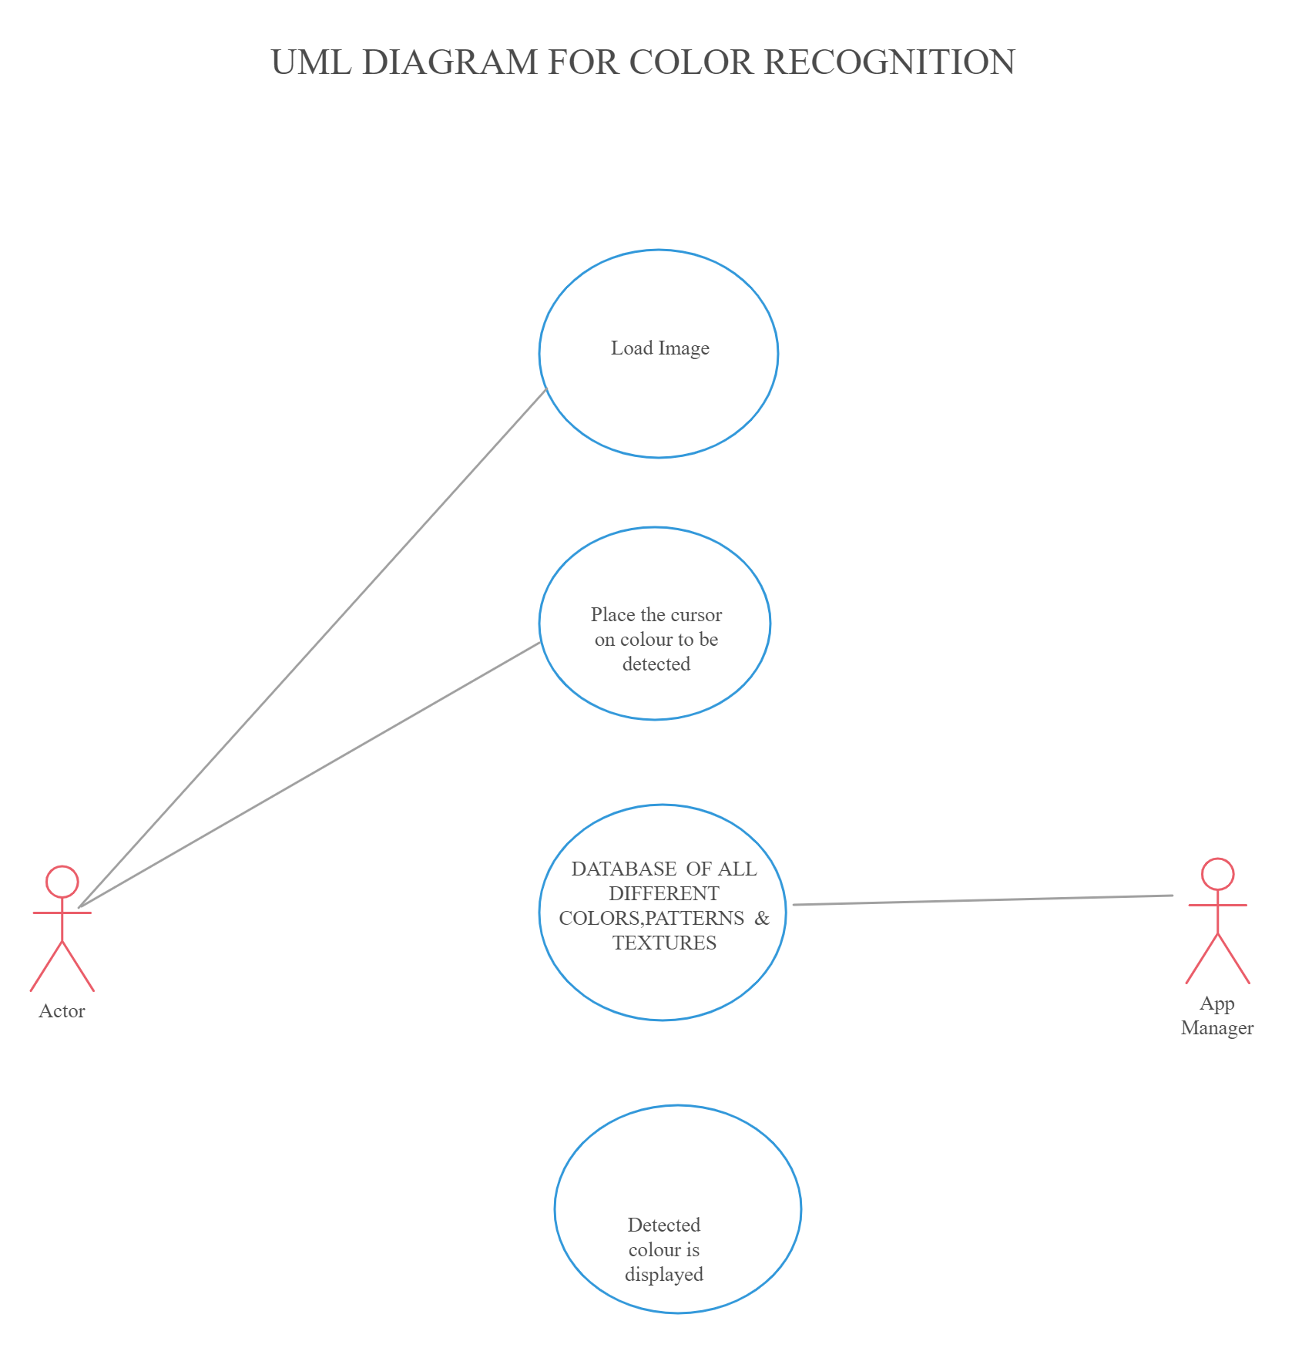
Use case diagram

Slide 11
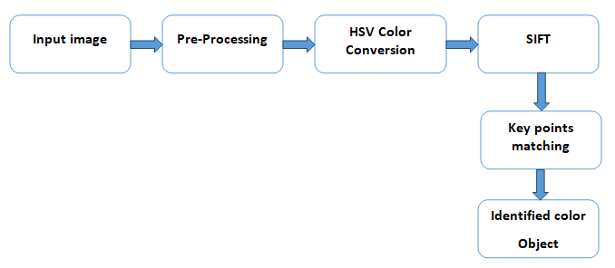
Activity Diagram

Slide 12
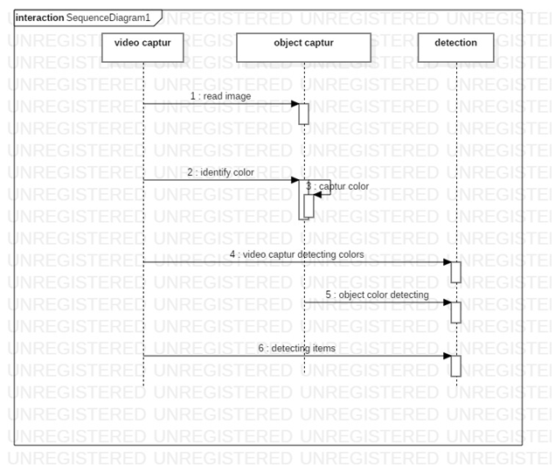
Sequence Diagram

Slide 13
APPLICATIONS
Numerous Image Editing Apps
Drawing Apps
In the field of Image Processing
RGB LED consistency control
Animations

Slide 14
coding

Slide 15
Modules
Tkinter – GUI
Cv2
Numpy
Pandas
Imutils – Video resize
The given modules are used foe execution of the code

Slide 16
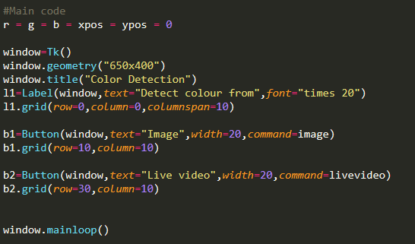
Main code
The given gui code is for main window to give options for the user to choose image or live video

Slide 17
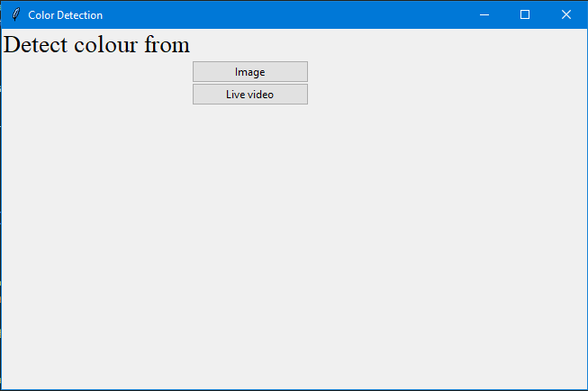
Main page
Here the user can choose whether he needs image or live video capture for colour detection.

Slide 18
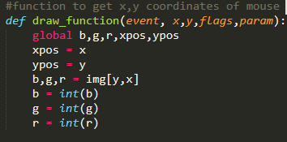
Image
For browsing a image from local files a method is called:
Function to note down the image coordinates and rgb values of that coordinate
If user choose then a window appears to choose image
The image path is stored into img variable
Then the img variable is used to open the specified image using cv2 module

Slide 19
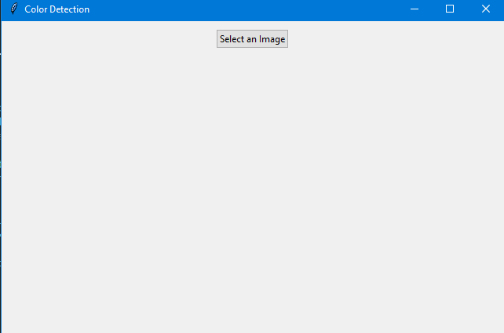
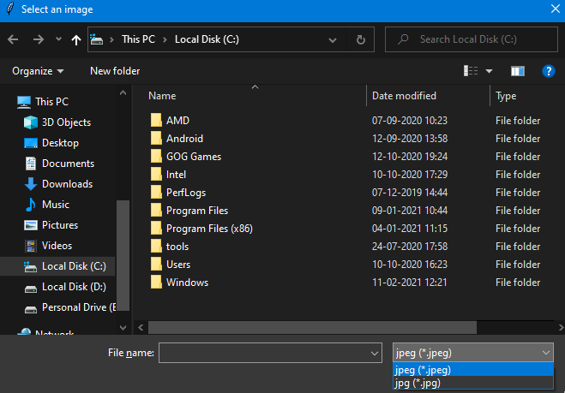
image
If the user selects image then a window appears to browse a image.
The file path initial showed is C drive and allowed file types are jpeg and jpg.

Slide 20
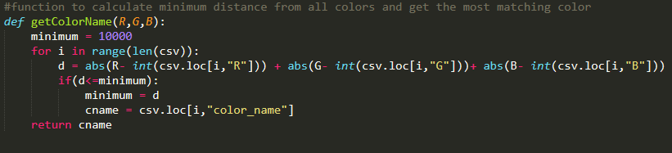
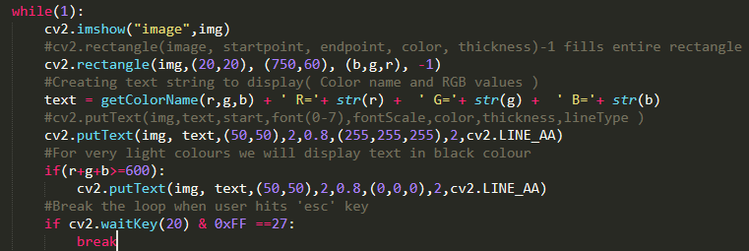
Function to calculate colour using rgb values
A while loop is called for continue evaluation of the mouse moment and display colour .
The rgb values are used to calculate min distance from all colours and get the most matching colour
Here the data is used from the csv file

Slide 21
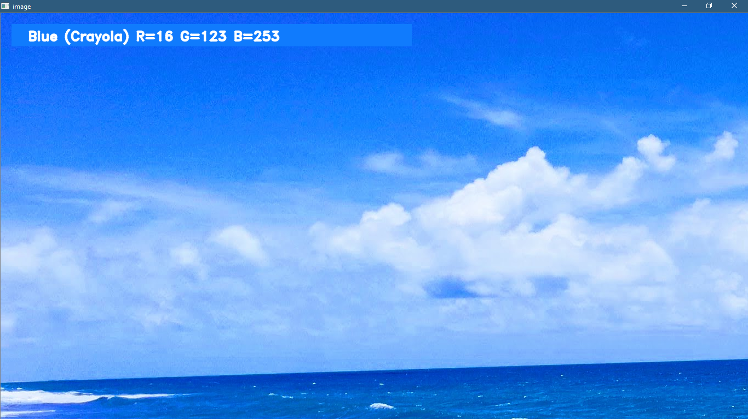
OUTPUT
The colour will be displayed as shown in the figure when mouse is placed on specified colour.

Slide 22
Live Video
The system comprises of 4 major steps as follows:
Activate Webcam:
User opened the webcam by clicking button on screen
Scan object part within the camera frame:
Algorithm analysis the pattern of framed part.
Matching framed part:
Pattern matched with defined colour pattern by rgb colour model
System result:
If pattern matched with potential pattern of rgb colour model then system output the correct result

Slide 23
The live video and image has similar functions.
IMAGE
LIVE VIDEO
Input is image
cv2.imshow("image",img)
Input is live video
camera = cv2.VideoCapture(1) --- grabbed, frame= camera.read()
frame = imutils.resize(frame, width=900)

Slide 24
THANK YOU

Slide 25


G Abhinaya Sri G phanindhar
M akila reddy
17911A1214 17911A1215
17911A1232

